Slide 1
Preparation of spatial covariates
for digital soil mapping

Slide 2
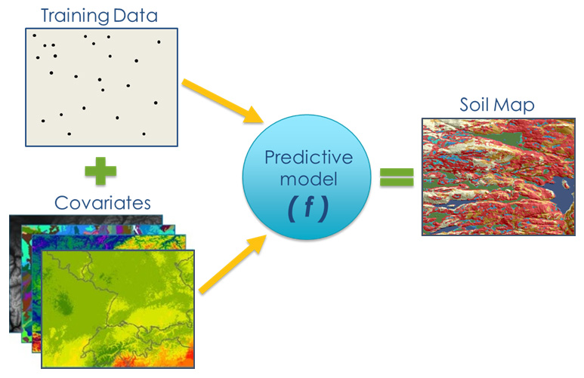
Digital Soil Mapping (DSM)
Step1 Done
Step2
pending

Slide 3
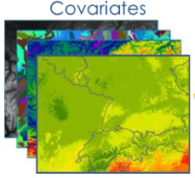
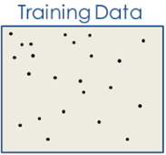
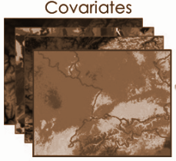
What are covariates?
In the SCORPAN reference framework a soil attribute (e.g., SOC) can be predicted as a function of the soil forming environment, in correspondence with soil forming factors based on climate, organisms, relief, parent material and elapsed time of soil formation (Florinsky, 2012)
SCORPAN MODEL
S = ƒ(s, c, o, r, p, a, n)+ ε
soil attribute to predict
soil prop.
climate
organisms
relief
parent mat.
age
location
function residuals (errors)
Covariates
&/or
Other soil properties (e.q. Soil map, pH, ect.)

Slide 4
Soil Properties
Soil data:
Soil Samples
Profiles
Soil maps (soil type, soil property maps)
It can be the soil property itself or a soil property that is correlated with the soil property we’re trying to predict
Why do we need SOC data if we’re trying to predict SOC?
Model calibration → using soil data to improve your models (if you want to create a model to identify cookies it’s useful to make it first taste cookies)
Validation → comparing predicted vs actual soil properties

Slide 5
Climate
Some common climatic variables that are regularly observed and mapped over countries are:
minimum and maximum temperature
cumulated temperature and mean temperature
cumulated precipitation and mean precipitation
potential evapotranspiration
climatic water balance
radiation
snow cover etc..
WorldClim V1.4 and V2 is a set of global climate layers (gridded climate data) with a spatial resolution of about 1 km2
WorldClim data layers were generated by interpolation of average monthly climate data from weather stations

Slide 6
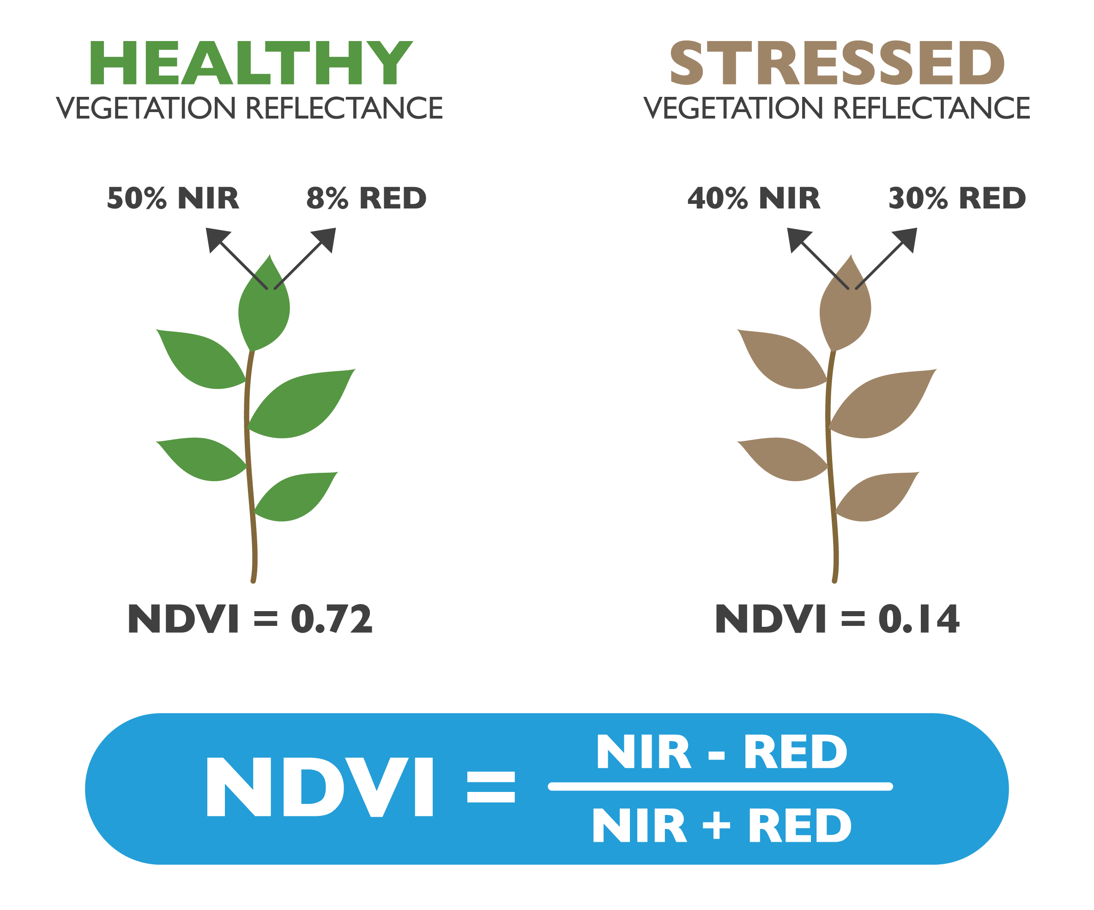
Organisms
A vegetation index is an indicator that describes the greenness, the relative density and health of vegetation for each pixel, in a satellite image
Although there are several vegetation indices, one of the most widely used is the Normalized Difference Vegetation Index (NDVI)
Normalized Difference Vegetation Index (NDVI) quantifies vegetation by measuring the difference between near-infrared (which vegetation strongly reflects) and red light (which vegetation absorbs
The enhanced vegetation index (EVI) was developed as an alternative vegetation index to address some of the limitations of the NDVI

Slide 7
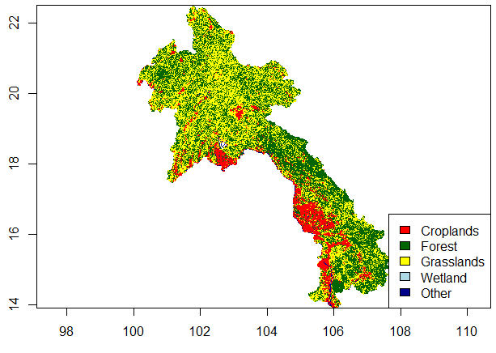
Organisms
Land cover maps represent spatial information on different types (classes) of physical coverage of the Earth's surface, e.g. forests, grasslands, croplands, lakes, wetlands
Land cover maps are a great asset for predicting soil properties, since the type of vegetation greatly affects them
There are several free global and continental datasets of land cover maps GlobCover, GeoCover, Globeland30, CORINE Land Cover.

Slide 8
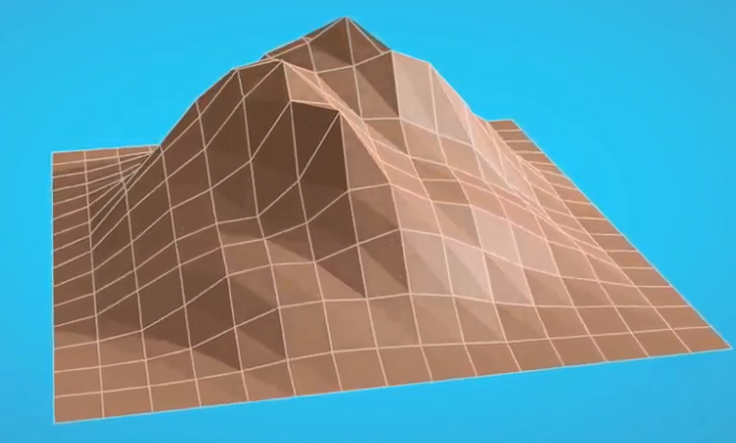
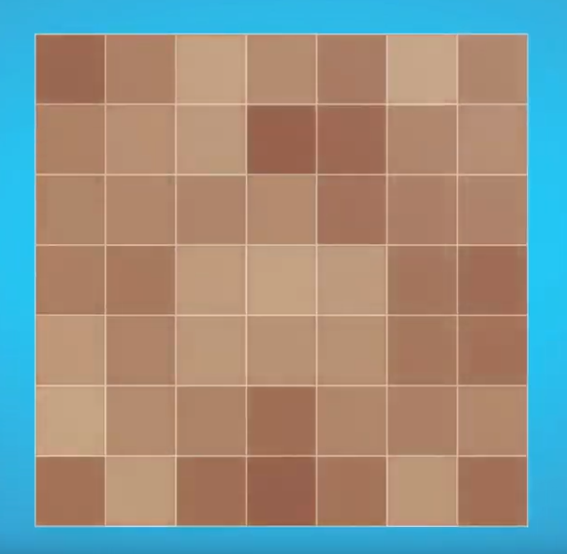
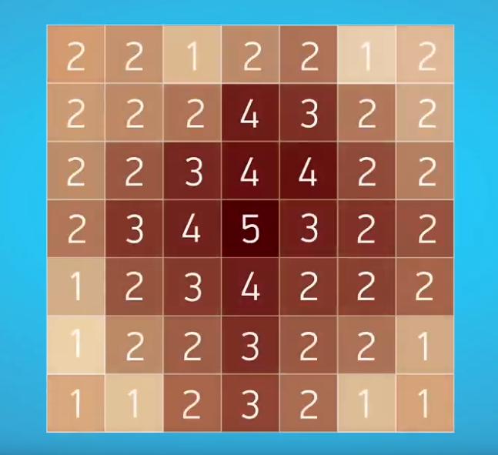
Relief
Digital Elevation Models (DEM) translate elevation values into grid cells
Several indices (e.g. terrain slope, valley depth)
Currently, two global level 30m DEMs are freely available; the Shuttle Radar Topographic Mission (SRTM) and the ASTER Global Digital Elevation Model (GDEM). They provide topographic data on the global scale, which are freely available for users

Slide 9
Parent Material
National parent material and geology maps may be used. Other available datasets and data portals are given on the Isric WorldGrids website (worldgrids.org)
Data sources for parent material maps are:
OneGeology
USGS
GLiM
SCORPAN MODEL
S = ƒ(s, c, o, r, p, a, n)+ ε
soil attribute to predict
soil prop.
climate
organisms
relief
parent mat.
age
location
function residuals (errors)

Slide 10
Selecting covariates
The example covariates from this chapter were prepared by ISRIC (ISRIC, 2017)
ISRIC World Soil Information has established a data repository which contains raster layers of various biophysical earth surface properties for each territory in the world
The 171 raster layers are divided per country and can be retrieved here: https://files.isric.org/projects/gsp/
User name: gsp
Password: gspisric

Slide 11
Selecting Covariates
Adding relevant covariates that can help explain the distribution of soil properties increases the accuracy of spatial predictions
Following the SCORPAN model is a good strategy, but one must keep in mind that certain factors are more important e.g. in the tropics than in temperate regions
We will work with 23 covariates from ISRIC, a histosol layer retrieved from the Harmonized World
Soil Database (HWSD) and a land cover map derived from CORINE

Slide 12
List of Covariates I
B04CHE3 | Temperature seasonality at 1 km (based on CHELSA climate surfaces).
B07CHE3 | Temperature Annual Range [°C] at 1 km (based on CHELSA climate surfaces).
B13CHE3 | Precipitation of wettest month [mm] at 1 km (based on CHELSA climate surfaces).
B14CHE3 | Precipitation of driest month [mm] at 1 km (based on CHELSA climate surfaces).
BARL10 | Global 30m Bare Ground (circa 2010)
DEMENV5 | Land surface elevation
ENTENV3 | Attribute derived from EVI
EVEENV3 | Attribute derived from EVI
Soil types | Soil types layer from the Harmonized World Soil Database (HWSD)
MAXENV3 | EVI
NIRL00 | Mean NIR reflectance for the year 2000
PRSCHE3 | Total annual precipitation at 1 km

Slide 13
List of Covariates II
RANENV3 | Attribute derived from EVI
REDL00 | Landsat Band 3 (red) for year 2000
SLPMRG5 | Terrain slope
SW1L00 | Landsat Band 5 (SWIR) for year 2000
SW2L00 | Landsat Band 7 (SWIR) for year 2000
TMDMOD3 | Mean annual LST (daytime) MODIS
TMNMOD3 | Mean annual LST (nighttime) MODIS
TPIMRG5 | Topographic Position Index
TREL10 | Global 30m Tree Cover
TWIMRG5 | SAGA Wetness Index
VBFMRG5 | Multiresolution Index of Valley Bottom Flatness (MRVBF)
VDPMRG5 | Valley depth
Hist | Histosol layer from ISRIC

Slide 14
Preparation of Spatial Covariates
In this exercise we’re going to focus on some routine steps required to prepare the covariates before modelling:
Prepare a RasterStack
Create a SpatialPointsDataFrame
Extract data from the Rasterstack and merge it with our data
Check which covariates are correlated with the target variable
Subset the Rasterstack
Reproject a land cover map
Rasterize a soil type map
Mask our stacked covariates
Save the rasterStack as .RData

Slide 15
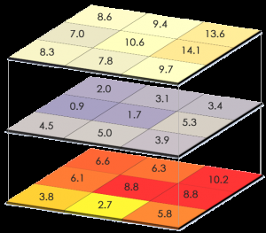
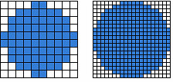
The RasterStack
Most of the functions for handling raster data are available in the raster package
Multiple layers can be combined into the object class RasterStack, which allows you to perform things on multiple rasters at once
Rasters can be stacked only if they have the same:
Extent (or in other words they cover the same area),
The same file extension
Same projection
Pixel resolution (cell size)

Slide 16
RasterStack
As a first step we’re going to create a character vector containing all the names of the covariates with the list.files() function
Covariate names will be selected based if the end with .tif
This will tell R which covariates to stack when using the stack() function
#Empty the environment - set the wd - activate needed packages
rm(list=ls())
setwd('C:/Users/hp/Documents/FAO/EduSoils/training_material')
library(raster)
#Create a list of files to load them in all at once in out R session
files <- list.files(path = "01-Data/covs", pattern = "tif*$",
full.names = TRUE)
covs <- stack(files)

Slide 17
RasterStack
We can treat the rasterstack similarly to a dataframe
Just like with the a dataframe we can use $ to select which covariate we want to explore
# Explore the data
names(covs)
plot(covs$DEMENV5)
Question 1: What’s the highest total annual precipitation for Macedonia?

Slide 18
SpatialPointsDataFrame
SpatialPointsDataFrame structure is essentially like a data frame, except that additional “spatial” elements have been added
To define the CRS, we must know where our data is from, and what was the corresponding CRS used when recording the spatial information in the field
First we’re going to import a dataframe
# Load the processed data for digital soil mapping. This table was #prepared in the 'data_preparation_profiles' script
dat <- read.csv("02-Outputs/dat_train.csv")
# Upgrade points data frame to SpatialPointsDataFrame amd define their coordinate system
coordinates(dat) <- ~ X + Y
proj4string(dat) = CRS("+init=epsg:4326") # WGS84

Slide 19
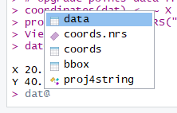
SpatialPointsDataFrame
SpatialPointsDataFrame structure is essentially like a data frame, except that additional “spatial” elements have been added
The spatial components that were added to the dataframe can be explored with the @ symbol
#To explore single columns use @ and then $
dat@data$SOC
In GIS terminology this is now the attribute table
And index indicating which columns have XY coordinates and the matrix containing the XY columns
The Bounding Box
Object of class "CRS" projection string

Slide 20
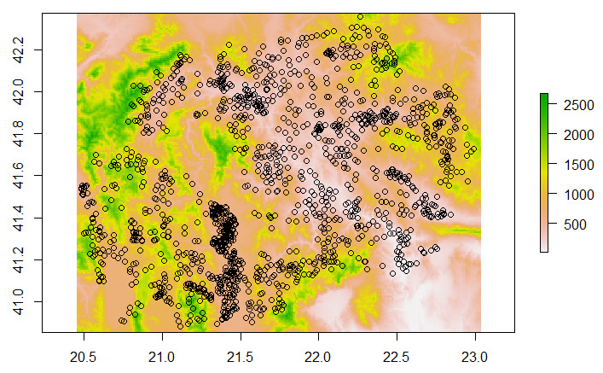
Extract data from the Rasterstack
With the extract function we can now add the values of the Rasterstack to the SpatialPointsDataFrame
Y in our argument corresponds to our point data
The extract function will extract a value
only where the points overlay a raster cell
# Check that the points overlay with the
#rasters
plot(covs$DEMENV5)
points(dat)

Slide 21
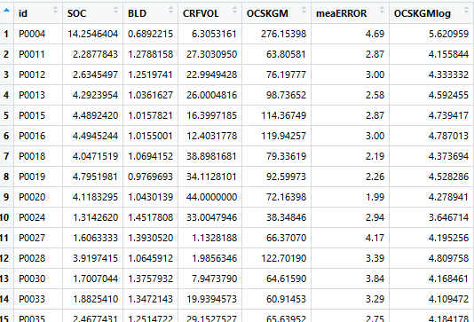
Extract data from the Rasterstack
In the extract() function we’re defining which object contains rasters (=x) and which object is made out of discrete locations (=y)
By putting sp= TRUE we’re telling are that the y object has a spatial component
# Extract values
dat <- extract(x = covs, y = dat,
df = TRUE)
summary(dat)

Slide 22
Check for correlation
# Remove NA values
dat <- dat[complete.cases(dat),]
# Test correlation between each covariate and the 'OCSKGMlog' and #the other covariates, select with []
names(dat)
test_covs <- cor(x = as.matrix(dat[,8]),
y = as.matrix(dat[,c(9:33)]))
test_covs

Slide 23
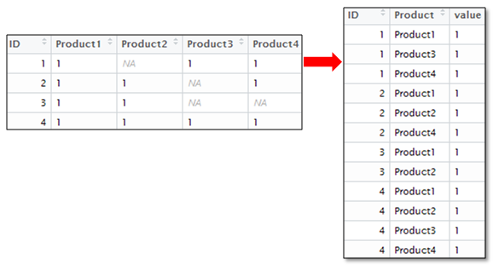
Check for correlation
Let’s Select only the covariates that have correlation higher than 0.3
library(reshape)
#Let’s get rid of NAs and correlation = 1 and reshape test_covs
x <- subset(melt(test_covs), value != 1 | value != NA)
test_covs
#Arrange the the values in descending order
x <-x[with(x,order(-abs(x$value))),]
long-format
wide-format

Slide 24
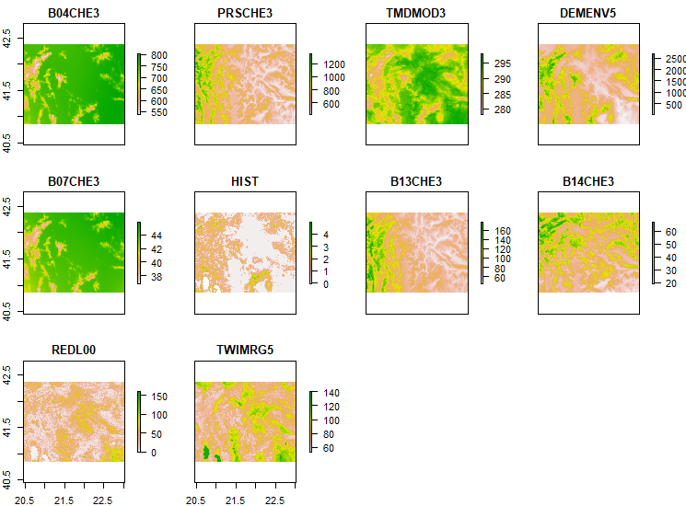
Subset the RasterStack
#Subset for values greater than 0.3
(x <- subset(x,abs(x$value)>0.3))
selection <- as.character(x$X2) #This creates and index
# Leave only selected covariates in the 'covs' raster stack
covs <- covs[[selection]]
names(covs)
plot(covs)

Slide 25
Reproject a land cover map
We want to add a new covariate from a different dataset
Rasters can be stacked only if they have the same:
Extent (or in other words they cover the same area),
The same file extension
Same projection
Pixel resolution (cell size)
In this example we’re loading a categorical land cover map into R
# Import land cover layer
landcover <- raster ('01-Data/land cover/LandCover.tif')
plot(landcover)
# Try to stack LandCover raster with the rest
covs <- stack(covs, landcover)

Slide 26
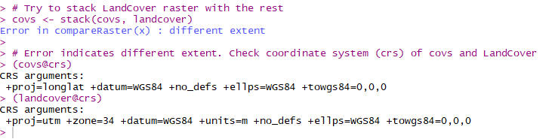
Reproject a land cover map
# Error indicates different extent.
#Check coordinate system (crs) of covs and LandCover
covs@crs
landcover@crs
'covs' has crs WGS 84, while landcover has crs UTM Zone 34

Slide 27
Reproject a land cover map
# 'covs' has crs WGS 84, while landcover has crs UTM Zone 34
# We need to reproject the 'Lancover' raster using one of the #'covs' as a template
landcover <- projectRaster(from = landcover, to = covs$DEMENV5, method = "ngb")
# Save the reprojected raster
writeRaster(landcover, '02-Outputs/Landcover_WGS84.tif', overwrite=TRUE)
# Now we can stack it with the other rasters
covs <- stack(covs, landcover)

Slide 28
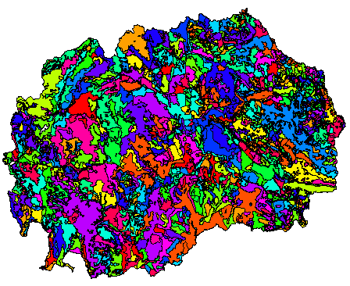
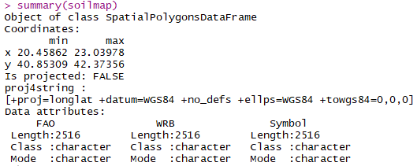
Rasterize a soil type map
Reading in a vector in shapefile (.shp) format is analogous to loading a raster into r: shapefile()
The function shapefile() is part of the package called raster
#Import and explore the soil map (vector polygon data)
soilmap<-shapefile("01-Data/Soil map/SoilTypes.shp")
plot(soilmap, col= rainbow(19))
summary(soilmap)

Slide 29


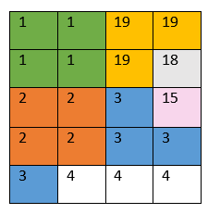
Rasterize a soil type map
Factors (categories) in R are stored as a vector of integer values with a corresponding set of character values
soilmap@data$Symbol <- as.factor(soilmap@data$Symbol)
str(soilmap@data)
Symbol
ATa
B
C
J

Slide 30
Rasterize a soil type map
The function rasterize() allows you to rasterize a shapefile according to another raster → the output will have the same spatial extent and resolution
# Rasterize the soil map using one of the 'covs' as a template and #'Symbol' as value field
soilmap.r <- rasterize(x = soilmap, fun='first', y = covs$DEMENV5, field = "Symbol")

Slide 31
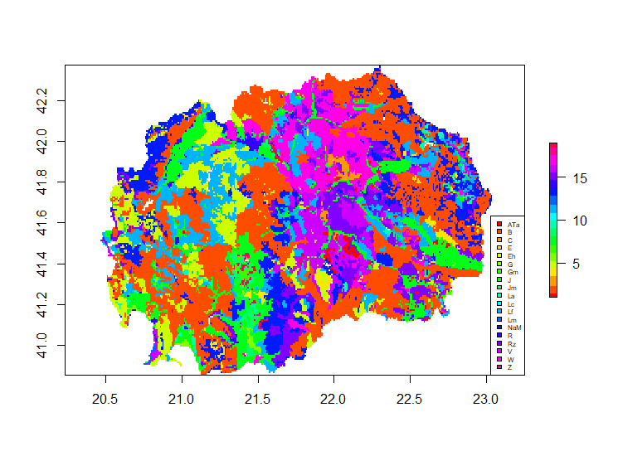
Rasterize a soil type map
Let’s see the difference: the borders are gone and now we have a raster with pixels containing numbers corresponding to each soil type sybol
# Explore the result
plot(soilmap.r, col=rainbow(20))
legend("bottomright",legend =
levels(soilmap$Symbol),
fill=rainbow(20),cex=0.5)

Slide 32
Rasterize a soil type map
# Save the rasterized map
writeRaster(soilmap.r, '02-Outputs/Soil_map.tif', overwrite=TRUE)
# Now we can stack it with the other rasters
covs <- stack(covs, soilmap.r)
names(covs)
# correct the name
names(covs)[names(covs)=='layer'] <- "soilmap"
Question 2: What would be another way to change the name of the layer?

Slide 33
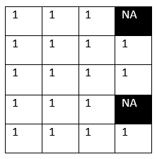
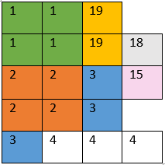
Mask values in a Raster object
Create a new raster that has the same values as x, except for the cells that are NA in the mask
This makes sense when mapping SOC and wanting to get rid of cells that are located on cities or water bodies
# Mask the covariates with the country mask
plot(covs$DEMENV5)
mask <- raster("01-Data/mask.tif")
plot(mask)
covs <- mask(x = covs, mask = mask)
plot(covs$DEMENV5)

Slide 34
Export the RasterStack as .RData
.RData → File created by R, saves a workspace, which includes the function and objects created during an open session in R; used for storing a working environment that can be extended or modified later.
# export all the covariates in the R-object
save(covs, file = "02-Outputs/covariates.RData")

Slide 35
Select and prepare the covariate stack
to map clay content

Slide 36
Thank you for your attention !

